Slide 1
Oncology Practice in the Era of COVID-19 Podcast Summary June 4, 2020

Slide 2
Introduction and methodology
In late May, 2020, Healogix recorded a podcast to discuss the effects of the ongoing COVID-19 pandemic on oncology practices. Click here to access the podcast on the Healogix website.
This podcast was based on:
Four 30-minute qualitative dyad interviews of oncologists conducted by telephone on May 21 and 22, 2020 with a geographically dispersed sample of 8 oncologists in the US, including both academic and community and rural, suburban, and urban physicians
Brief review of secondary literature on this topic, including published accounts as well as electronic news sources such as Medscape and the ASCO Post
As with all qualitative research, findings should be interpreted with caution. These findings should be considered exploratory and directional in nature and not necessarily projectable to the entire population of oncologists in the US.

Slide 3
Changes in clinic organization due to COVID-19
Patient volumes are down across the board and practices are seeing fewer new patients
Routine cancer screening has been halted
Surgeries, particularly elective surgeries, have been postponed
Physicians are seeing fewer hospital consultations, particularly in harder hit areas
Diagnostic and staging tests, blood draws and biopsies, and follow-up imaging studies have also been postponed
Routine follow-up visits have been moved to telemedicine, and non-urgent visits have been postponed or moved to telemedicine – often at patient request
Patients are typically called before visits to screen for symptoms, temperature checks are instituted at the door, and patients are required to wear masks, and non-patients are not allowed in the office

Slide 4
Challenges of telemedicine
Telemedicine has become increasingly used for visits that do not require a physical examination
One ONC estimates that as much as 90% of her day is comprised of telemedicine visits
It is somewhat less commonly used outside the Northeast
Practices face several challenges with telemedicine:
The need to settle on a platform to use for video calling
Reimbursement is significantly better for video calls than for phone calls
Older patients may struggle with video calling apps or technology and may prefer telephone calls
ONCs prefer not to give out personal numbers, but patients may not answer calls when Caller ID indicates a blocked or anonymous number
Many ONCs find telemedicine suboptimal for patient care and feel that medicine cannot be properly practiced “virtually”

Slide 5
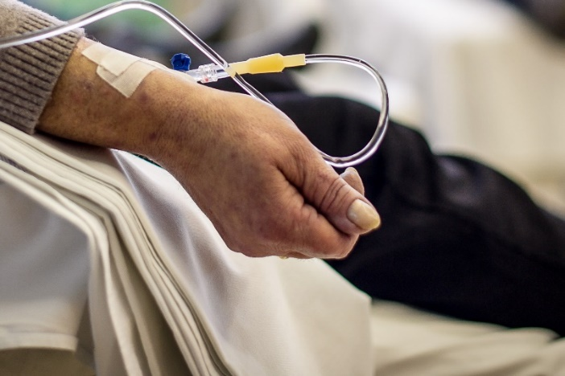
Effect of COVID-19 pandemic on treatment
For the most part, the pandemic has not interrupted the treatment of oncology patients, with some notable exceptions:
Neo-adjuvant (i.e., before surgery) therapy may be used in cases (e.g., ER/PR+ earlier-stage breast cancer) where surgeries have had to be postponed
Some patients may be considered for oral medications rather than IV medications, so that patients do not need to come to the clinic for therapy
Patients may be offered treatment holidays or dose reductions, particularly if they are immuno-compromised or not being treated in a curative setting
Growth factors may be used in place of transfusions, given blood shortages and the difficulty of organizing blood drives
Some supportive care measures (e.g., bone protective agents) have been put on hold
None of the ONCs we interviewed reported experiencing any medication shortages

Slide 6
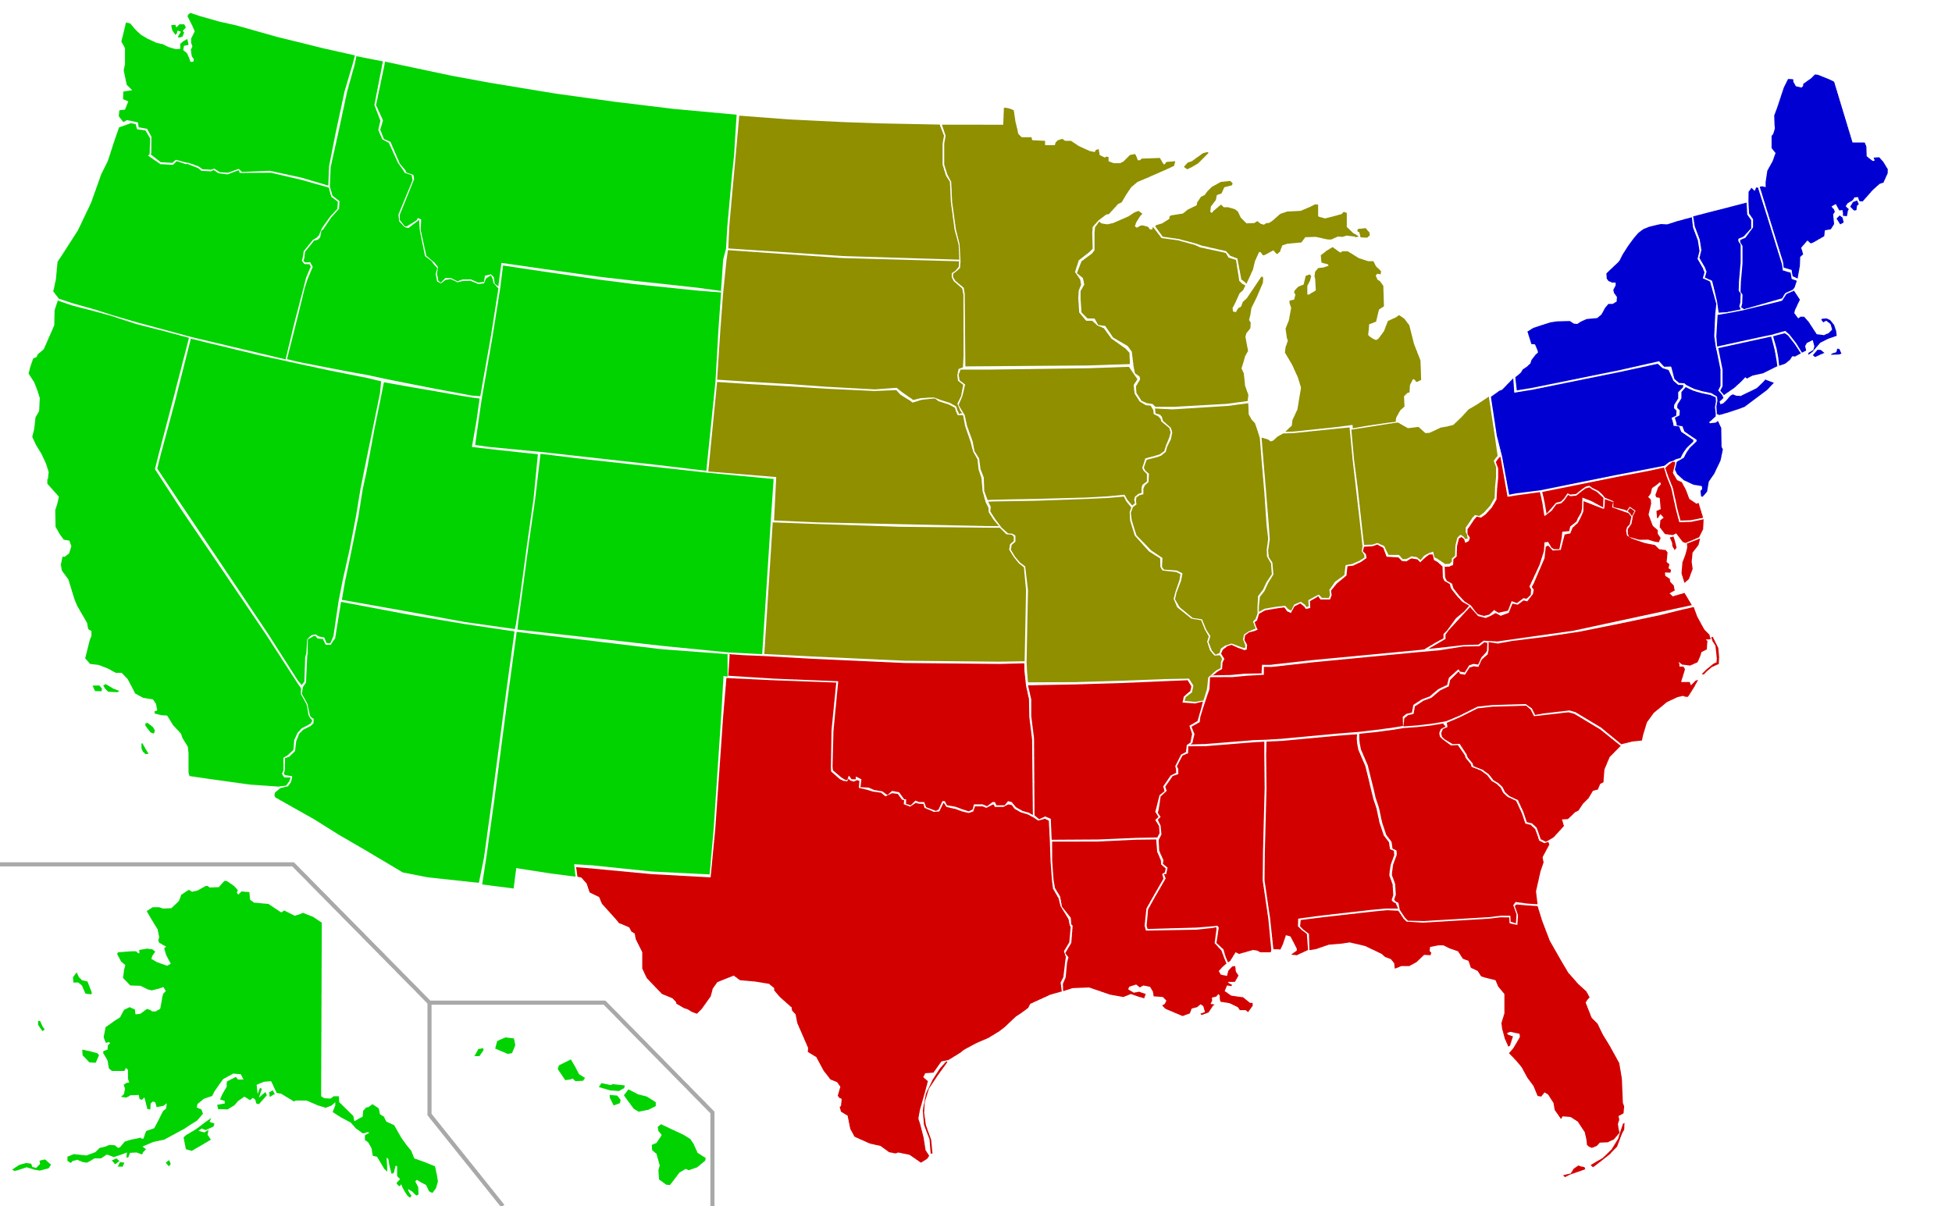
Regional variation
Region appears to be the strongest predictor of how oncology practices are being affected by, and responding to the pandemic
Practices in areas that were hardest hit by COVID-19 infections – the urban Northeast and Midwest, the New Orleans metropolitan area – have most dramatically altered their approach
Elsewhere, practices have seen less significant drops in patient volume, though they, too, are engaging in telemedicine where appropriate
Regardless of region, practices took a heavy hit to their financial bottom line in March and April, though several of the ONCs we interviewed report that recent weeks have been more “normal”

Slide 7
Clinical trials*
Clinical trial activity has declined markedly
A recent analysis of clinicaltrials.gov found that over 200 clinical trials in oncology have been put on hold since March
The NCI reports a 40% decline in trial enrollment, and the SWOG cooperative group reports a 50% decline
Several centers have reportedly chosen to delay or suspend trials because staff who would otherwise manage trials are needed for other responsibilities
ONCs also are reluctant to enroll patients in trials at this point because they would like to limit patient visits, which conflicts with the close monitoring required in trials
* Information taken in part from the ASCO Presscast “COVID-19 and Cancer: Addressing a Healthcare System in Crisis,” recorded April 23, 2020
7

Slide 8
Thank you!
Drew Cutler
Vice President
610.246.0961
drew.cutler@healogix.com
Michael Galvin
Vice President
267.432.9327
michael.galvin@healogix.com

